Slide 1
Quantitative Methods Lecture-6

Slide 2
Discreet Probability Distributions
(Ch 5 Business Statistics, Levine et al.)

Slide 3
So far and the next
Previous Sessions
Defining and collecting data
Survey and sampling methods
Organizing and visualizing variables
Numerical descriptive measures
Probability
Today
Discreet Probability Distributions

Slide 4
Sample space and Random Variable
You have 2 machines in your factory
Each machine can be “working” or “not-working” decided by a random process
Sample space?
S = { “Working, Working”,
“Working, Not-Working”,
“Not-Working, Working”,
“Not-working, Not-Working” }
Does the sample space contain numbers?
A “Random Variable (RV)” maps the sample space on a real number line (R)
Can take some or all real values between -∞ and ∞

Slide 5
Sample space and Random Variable
A “Random Variable (RV)” maps the sample space on a real number line (R)
One to one or many to one mapping
Can take some or all real values between -∞ and ∞
S = {
“Working, Working”,
“Working, Not-Working”,
“Not-Working, Working”,
“Not-working, Not-Working” }
Example 1:
Random Variable: X, representing number of working machines on a given day.
How many values can X take?
X = { 0, 1, 2 }
Sample space of an Random Variable X consists of Real Numbers 0, 1 and 2
1
2
3
R
-1
0

Slide 6
Sample space and Random Variable
A “Random Variable (RV)” maps the sample space on a real number line (R)
Can take some or all real values between -∞ and ∞
S = {
“Working, Working”,
“Working, Not-Working”,
“Not-Working, Working”,
“Not-working, Not-Working” }
Example 2:
Random Variable: Y, representing whether all the machines are working today.
Takes value 1 if all the machines are working, 0 otherwise
How many values can Y take?
Y = { 0, 1 }
Sample space of an RV consists of Real Numbers
1
2
3
R
-1
0

Slide 7
Discreet and Continuous Random Variables
A “Discreet Random Variable (RV)”
Takes discreet values
Previous example (Note: There were no values for X or Y between 0 and 1)
Number of students present in this class on a given day, number of questions in an exam paper
A “Continuous Random Variable (RV)” can take any (infinite values) between any two numbers
Height of the students of this class
Diameter of a machine component

Slide 8
Probability Distribution of a Discreet RV
Probability distribution of a discreet RV is all the possible (Value, Probability) pairs
Also called probability mass function (PMF)
Example: You have two machines in your factory. Probability of a machine working on a given day is 0.8.
Random variable X represents number of machines working on a given day.
What is the probability distribution of X
{(0, 0.04), (1, 0.32), (2, 0.64)}
P(X)
.64
X | Probability | Cumulative Probability
0 | 0.04 | 0.04
1 | 0.32 | 0.36
2 | 0.64 | 1
Total | 1
.32
.04
X
0
1
2
3
Probability distribution of X

Slide 9
Cumulative Probability Distribution
Cumulative probability distribution is distribution of P(X<=x)
What is the cumulative probability distribution of X (Previous Example)?
P(X<=x)
1
.36
.04
X
0
1
2
X | Probability | Cumulative Probability
0 | 0.04 | 0.04
1 | 0.32 | 0.36
2 | 0.64 | 1
Total | 1
Cumulative Probability distribution of X
What is P (X <=0.5)?
What is P (X<3)?

Slide 10
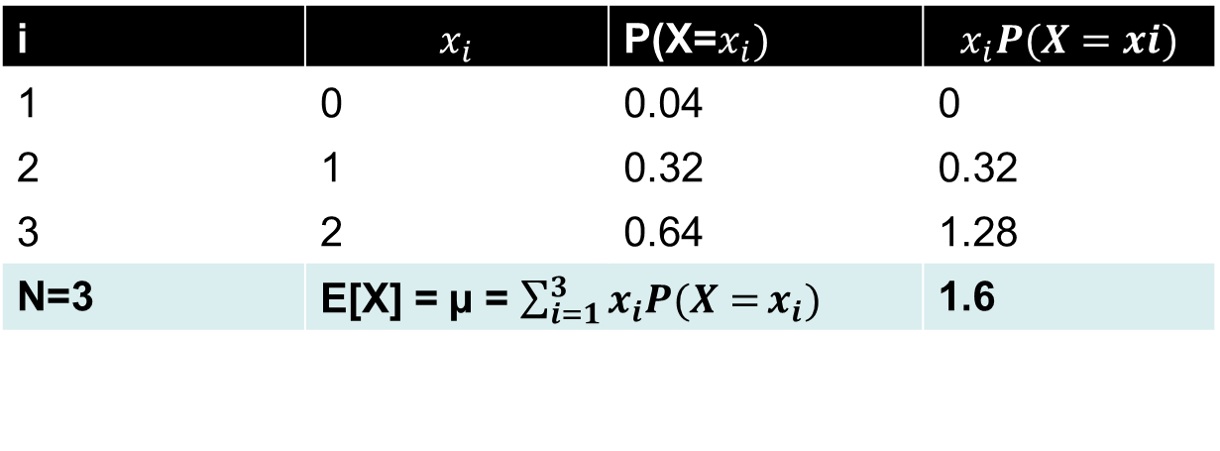

Expected Value of a Random Variable
E[X] = µ = $\sum_{i=1}^{N}{x_{i}P(X=}x_{i})$
N= total number of values
$x_{i}$= i^{th} value
$P$(X = $x_{i})$ probability of X taking value xi
Also referred to as mean by some of the books
P(X)
.64
E[X]
.32
i | $$x_{i}$$ | P(X=$x_{i})$ | $$x_{i}P(X=xi)$$
1 | 0 | 0.04 | 0
2 | 1 | 0.32 | 0.32
3 | 2 | 0.64 | 1.28
N=3 | E[X] = µ = $\sum_{i=1}^{3}{x_{i}P(X=}x_{i})$ |  | 1.6
.04
X
0
1
2
3
Probability distribution of X

Slide 11
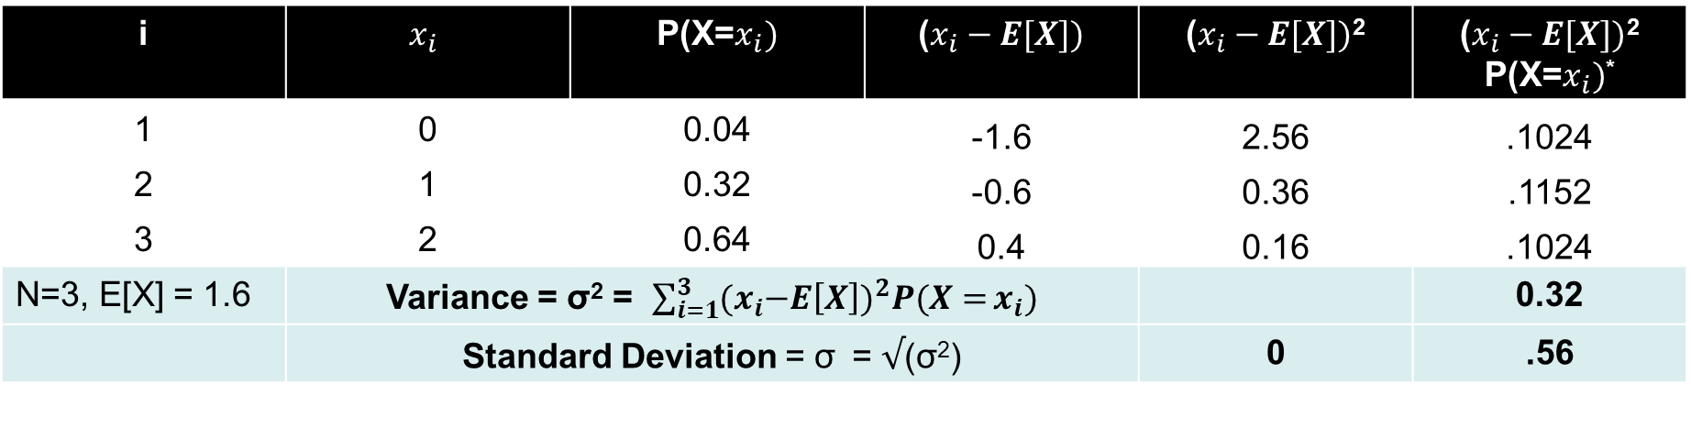

Variance and Standard Deviation
Variance: Probability weighted sum of the squares of the deviation of each value of the random variable from the expected value of the probability distribution.
σ² = $\sum_{i=1}^{N}{{{(x}_{i}−E\left[X\right])}^{2}P(X=}x_{i})$
N= total number of values, $x_{i}$= i^{th} value
$P$(X = $x_{i})$ probability of X taking value xi
i | $$x_{i}$$ | P(X=$x_{i})$ | ($x_{i}−E[X])$ | ($x_{i}−E[X])$² | ($x_{i}−E[X])$² P(X=$x_{i})$*
1 | 0 | 0.04 | -1.6 | 2.56 | .1024
2 | 1 | 0.32 | -0.6 | 0.36 | .1152
3 | 2 | 0.64 | 0.4 | 0.16 | .1024
N=3, E[X] = 1.6 | Variance = σ² = $\sum_{i=1}^{3}{{{(x}_{i}−E\left[X\right])}^{2}P(X=}x_{i})$ |  |  |  | 0.32
 | Standard Deviation = σ = $√$(σ²) |  |  | 0 | .56

Slide 12
Parametric Probability Distributions (Models)
Why?
If you have 100 machines, what is the probability that more than 20 machines would not work on a given day?
What is the expected value of “Machines not working” on a given day. What is the variance?
Many real life situations are similar
For a well defined problem that meets certain criteria
Parametric probability models help us quickly calculate the probabilities, variance, expected value etc. using a generic formula

Slide 13
Binomial distribution

Slide 14
Binomial Distribution
Binomial Random Variable
A random variable representing number of successful events in n trials
Properties of a binomial distribution
The sample has fixed number of observations: n
Each observation consists of the possibility of two mutually exclusive and collectively exhaustive outcomes
Probability of the event of interest is constant across observations. So, P (Event) is fixed
Value of any observation is independent of any other observation

Slide 15
Binomial Distribution
For toss of a coin experiment, the Random Variable X represents number of heads in 10 trials
Is X a Binomial RV?
Does X represent number of successful events in n trials?
Does the sample have fixed number of observations: n?
Does each observation consist of the possibility of “two” mutually exclusive and collectively exhaustive outcomes?
Is the probability of the event of interest constant across observations?
Does the value of any observation independent of any other observation?
X is a Binomial RV

Slide 16
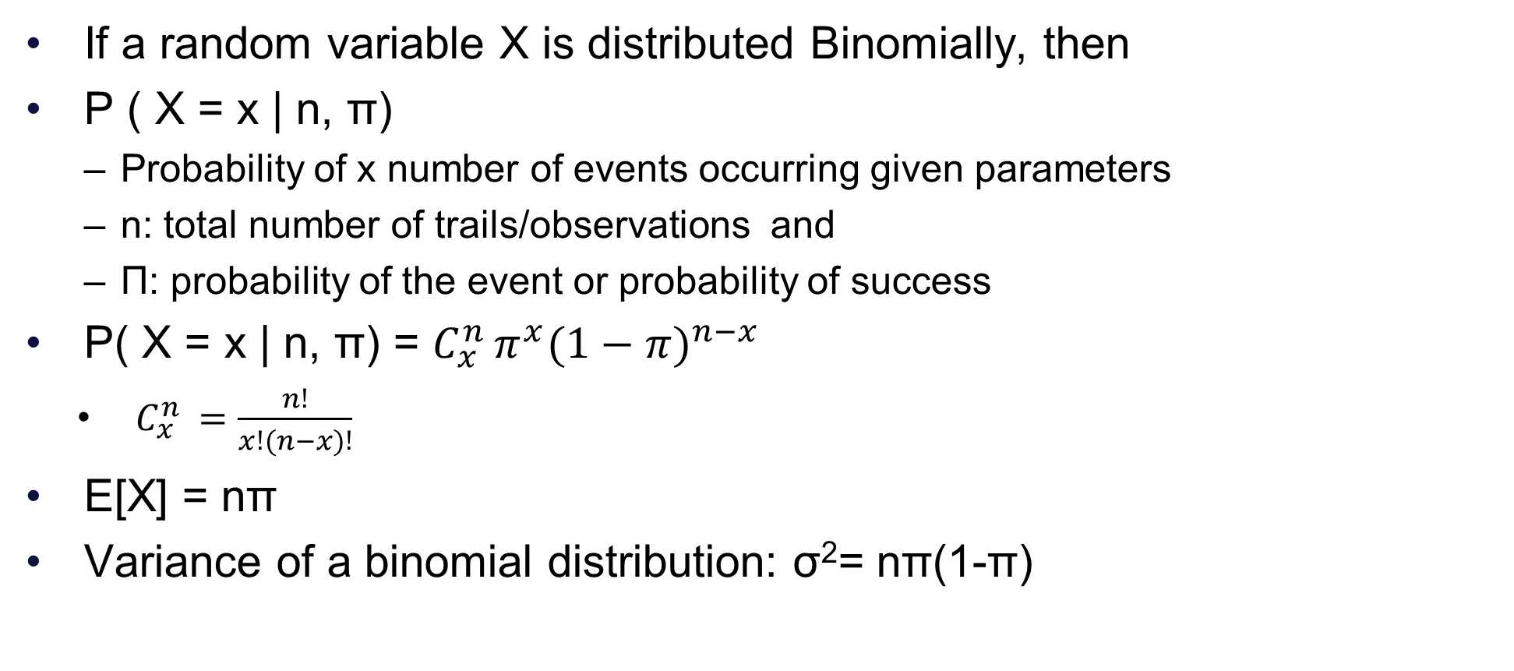
Binomial Distribution
If a random variable X is distributed Binomially, then
P ( X = x | n, π)
Probability of x number of events occurring given parameters
n: total number of trails/observations and
Π: probability of the event or probability of success
P( X = x | n, π) = $C_{x}^{n }π^{x}(1−{π)}^{n−x}$
$C_{x}^{n }=\frac{n!}{x!(n−x)!}$
E[X] = nπ
Variance of a binomial distribution: σ²= nπ(1-π)

Slide 17
Binomial Distribution
Probability distribution of ‘x’ machines failing out of total ‘10’
Or ‘x’ heads in 10 trials of a coin
For different values of probability of the event (π)

Slide 18
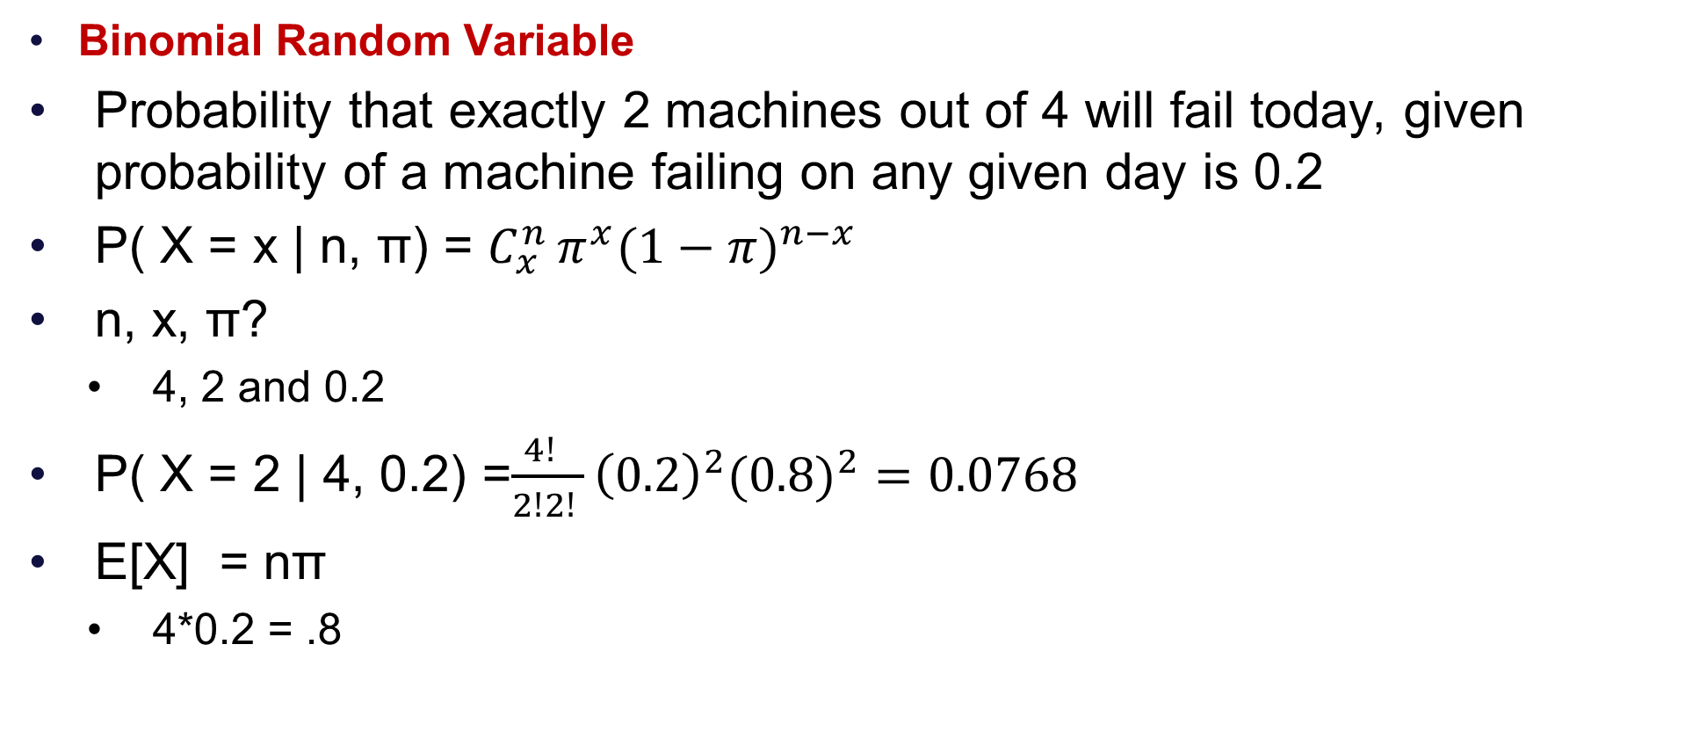
Binomial Distribution
Binomial Random Variable
Probability that exactly 2 machines out of 4 will fail today, given probability of a machine failing on any given day is 0.2
P( X = x | n, π) = $C_{x}^{n }π^{x}(1−{π)}^{n−x}$
n, x, π?
4, 2 and 0.2
P( X = 2 | 4, 0.2) =$\frac{4! }{2!2! }{\left(0.2\right)}^{2}(0.8)^{2}=0.0768$
E[X] = nπ
4*0.2 = .8
XL Formula: BINOM.DIST(x, mean, false)

Slide 19
An application of Binomial distribution

Slide 20
Binomial Distribution
Binomial Random Variable
You have 50 machines in your factory, probability of failure of a machine on a given day is 0.2
One mechanic can only fix a maximum of 5 machines the same day they go out of order
You want at least 95% chance that all the out of order machines would be fixed the same day
How many mechanics should you hire?
What if you want to be 100% confident?
n=50
π | 0.2
One mechanic capacity | 5
Number of events | P(x) | CumulativeProb | Mechanics Required
0 | 0.0000 | 0.0000 | 0
1 | 0.0002 | 0.0002 | 0.2
2 | 0.0011 | 0.0013 | 0.4
3 | 0.0044 | 0.0057 | 0.6
4 | 0.0128 | 0.0185 | 0.8
5 | 0.0295 | 0.0480 | 1
6 | 0.0554 | 0.1034 | 1.2
7 | 0.0870 | 0.1904 | 1.4
8 | 0.1169 | 0.3073 | 1.6
9 | 0.1364 | 0.4437 | 1.8
10 | 0.1398 | 0.5836 | 2
11 | 0.1271 | 0.7107 | 2.2
12 | 0.1033 | 0.8139 | 2.4
13 | 0.0755 | 0.8894 | 2.6
14 | 0.0499 | 0.9393 | 2.8
15 | 0.0299 | 0.9692 | 3
XL Formula: BINOM.DIST(x, mean, cumulative=false) or BINOM.DIST(x, mean, true)

Slide 21
Binomial Distribution
Binomial Random Variable
You have 50 machines in your factory, probability of failure of a machine on a given day is 0.2
How many machines do you expect to be out of order any given day?
E[X] = nπ
E[X] = 50*0.2 = 10
What is the chance that less than 5 machines would be out of order?
P(X<=4) = 0.0185
What is the chance that exactly 5 or 10 machines would be out of order
P(X=5) + P(X=10) = .0295 + 0.1398
n=50
π | 0.2
One mechanic capacity | 5
Number of events | P(x) | CumulativeProb | Mechanics Required
0 | 0.0000 | 0.0000 | 0
1 | 0.0002 | 0.0002 | 0.2
2 | 0.0011 | 0.0013 | 0.4
3 | 0.0044 | 0.0057 | 0.6
4 | 0.0128 | 0.0185 | 0.8
5 | 0.0295 | 0.0480 | 1
6 | 0.0554 | 0.1034 | 1.2
7 | 0.0870 | 0.1904 | 1.4
8 | 0.1169 | 0.3073 | 1.6
9 | 0.1364 | 0.4437 | 1.8
10 | 0.1398 | 0.5836 | 2
11 | 0.1271 | 0.7107 | 2.2
12 | 0.1033 | 0.8139 | 2.4
13 | 0.0755 | 0.8894 | 2.6
14 | 0.0499 | 0.9393 | 2.8
15 | 0.0299 | 0.9692 | 3

Slide 22
Other examples of binomial distributions
For a shop floor manager, x number of employees calling it sick today out of total n
For a rental company, x number of cars expected to be in good conditions of total n
Expected number of defective parts out of a total n coming out the assembly line
Out of x customers approached, how many are expected to buy the product
XL Formula: BINOM.DIST(x, mean, cumulative=false) or BINOM.DIST(x, mean, true)

Slide 23
Poisson distribution

Slide 24
Poisson Distribution
Poisson Random Variable
Count of the events of interest occurring in an “Area of Opportunity”
Area of opportunity
Certain time-period, Space, Length etc
Examples of the “count of events” and “area of opportunity”
Number of cars arriving at a Toll booth in a 1 minute period
Number of defects per square inch in a product
Number of calls arriving at a call center in 2 minutes interval
Number of car crashes in a month on Mumbai Pune Highway

Slide 25
Poisson Distribution
Requirements
Probability of the event is same for all the areas of opportunity
Number of events occurring in one area of opportunity is independent of number of events occurring in other areas of opportunity
The probability that two or more events will occur in an area of opportunity approaches zero as the area of opportunity becomes extremely small
Examples
Number of customers arriving each minute during the lunch hour in a bank, number of defects per sq inch area etc.
Has one parameter λ (Lambda): Expected number of events per unit

Slide 26
Examples
Are the following example of Poisson distribution?
Number of customers arriving at a bank branch every minute during lunch hour
Requirements
Is the probability of the event same for all the areas of opportunity?
Are number of events occurring in one area of opportunity independent of number of events occurring in other areas of opportunity?
Does the probability of two or more events occuring in an area of opportunity approach zero as the area of opportunity becomes extremely small?
The problem can be modelled as Poisson distribution

Slide 27
Examples
Are the following example of Poisson distribution?
Number of customers arriving at a bank branch every hour during the day time
Requirements
Is the probability of the event same for all the areas of opportunity?
Not a good example of Poisson distribution

Slide 28
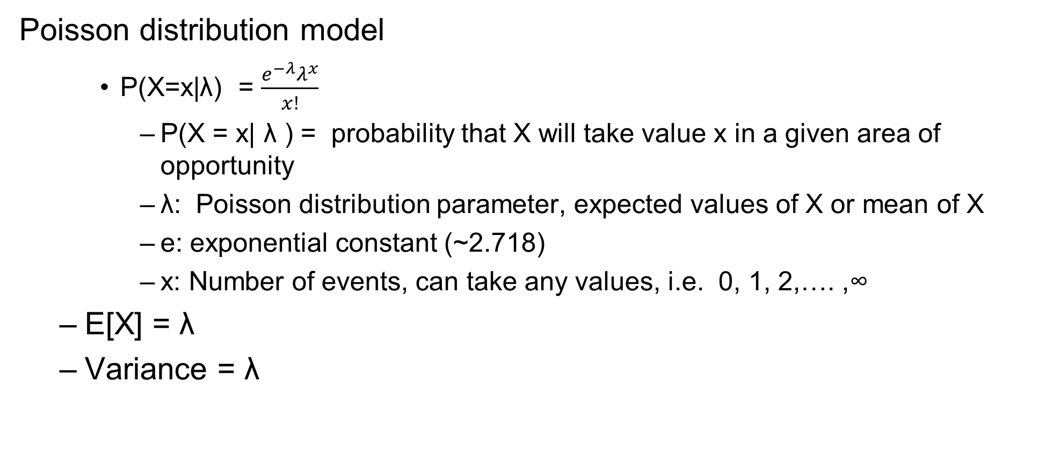
Poisson Distribution: Probability, Expectation and Variance
Poisson distribution model
P(X=x|λ) = $\frac{e^{−λ}λ^{x}}{x!}$
P(X = x| λ ) = probability that X will take value x in a given area of opportunity
λ: Poisson distribution parameter, expected values of X or mean of X
e: exponential constant (~2.718)
x: Number of events, can take any values, i.e. 0, 1, 2,…. ,∞
E[X] = λ
Variance = λ

Slide 29
Examples

Slide 30
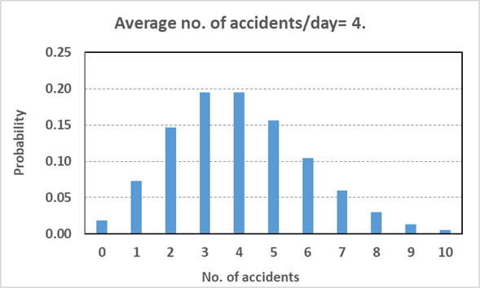
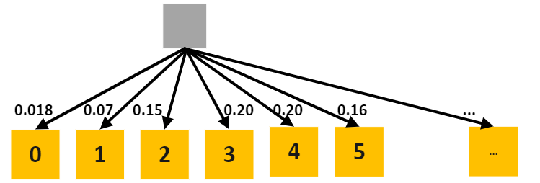
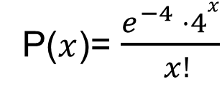
What is the Probability distribution?
Avg no. of no of accidents= 4/day.(arrival (occurrence) rate of accidents per day Probability of 0, 1, 2, 3, 4, 5… accidents?
Avg no. of no of potholes= 6/km. (occurrence rate of potholes per km) Probability of 0, 1, 2, 3, 4, 5… potholes?
Avg no. of goals= 3.2/match. Probability of 0, 1, 2, 3, 4, 5… goals?
Avg no. of typos= 2.7/page. Probability of 0, 1, 2, 3, 4, 5… typos?
5. Avg no. of teeth cavities= 3.28/patient. Probability of 0, 1, 2, 3, 4, 5… teeth cavities?
Solution of 1 above for Poisson distribution

Slide 31
An application of Poisson distribution

Slide 32
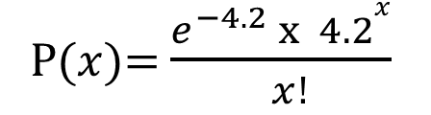
Ambulance service decision
Mean number of accidents (λ) |  | 4.2 |  |  |  | Fixed Cost | 8000
Number of Accidents | P(x) | Always Fast |  | Best and Fast |  | Carry Fast
 |  | Rate | Expected Cost | Rate | Expected Cost | Rate | Expected Cost
0 | 0.014996 | 3000 | 0.00 | 4000 | 0.00 | 0 | 0.00
1 | 0.062981 | 3000 | 188.94 | 4000 | 251.93 | 0 | 0.00
2 | 0.132261 | 3000 | 793.57 | 4000 | 1058.09 | 0 | 0.00
3 | 0.185165 | 3000 | 1666.49 | 4000 | 2221.98 | 0 | 0.00
4 | 0.194424 | 3000 | 2333.08 | 2000 | 1555.39 | 0 | 0.00
5 | 0.163316 | 3000 | 2449.74 | 2000 | 1633.16 | 0 | 0.00
6 | 0.114321 | 3000 | 2057.78 | 2000 | 1371.85 | 3000 | 2057.78
7 | 0.068593 | 3000 | 1440.45 | 2000 | 960.30 | 3000 | 1440.45
8 | 0.036011 | 3000 | 864.27 | 2000 | 576.18 | 3000 | 864.27
9 | 0.016805 | 3000 | 453.74 | 2000 | 302.49 | 3000 | 453.74
10 | 0.007058 | 3000 | 211.75 | 2000 | 141.16 | 3000 | 211.75
11 | 0.002695 | 3000 | 88.93 | 2000 | 59.29 | 3000 | 88.93
12 | 0.000943 | 3000 | 33.96 | 2000 | 22.64 | 3000 | 33.96
13 | 0.000305 | 3000 | 11.88 | 2000 | 7.92 | 3000 | 11.88
14 | 9.14E-05 | 3000 | 3.84 | 2000 | 2.56 | 3000 | 3.84
15 | 2.56E-05 | 3000 | 1.15 | 2000 | 0.77 | 3000 | 1.15
 |  | Variable (Exp) | 12599.57 |  | 10165.71 |  | 5167.75
 |  | Fixed Cost | 0 |  | 0 |  | 8000
 |  | Total | 12599.57 |  | 10165.71 |  | 13167.75
The average number of accidents reported in the factory is 4.2/month.
Assume the distribution of accidents is Poisson,
the manager of a factory has invited bids for ambulance service to take injured workers to a nearby hospital. Bids submitted by three service providers are as follows-
AlwaysFast services: Rs 3,000/case. (You can directly use expected value formula here)
BestAndFast services: Rs 4,000/case up to 3 cases in a month and Rs 2,000/case if cases in a month exceed 3.
CarryFast services: A fixed amount Rs 8,000/month and Rs 3,000/case if cases in a month exceed 5.
Which bid is the most economical?
XL Formula: POISSON.DIST(x, mean, false)

Slide 33


Q&A

